Slide 1
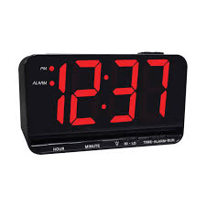


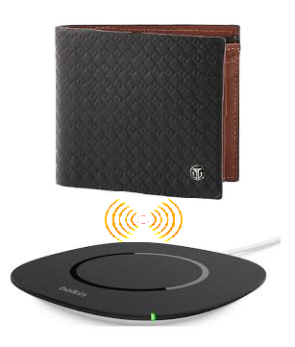

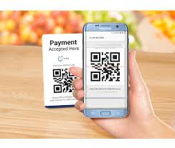
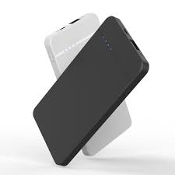
Smart wallet
TECH BEES
By,
RANJIT V S
SAI BHARATHWAJ S
MOHAMED AADHIL M

Slide 2
What is a smart wallet?
SMART WALLET = WALLET + BEYOND
A smart wallet that connects to your smartphone, so that you never lose your wallet or phone again! It's not just a wallet, but much more.
Smart Wallet is a compact sized wallet that is been integrated with small electronic components.

Slide 3
Abstract
It can display digital date,time,temperature & humidity. It can be used a small power backup for emergency cases and it is used to avoid carrying a power bank. It displays a QR code used exclusively for e-payments if the smartphones are dead and in case of its absence. The wallet has an inbuilt buzzer system used to locate it in case of misplacement. It can be used as a portable storage device to prevent carrying separate storage devices. The battery in the wallet powers the electronic components in it and can also be used as a power backup. *The wallet’s battery can be recharged with a wireless charger, so that the wallet need not be connected to a charger.*The wallet’s battery can be charged via piezo electric transducer ( Generates an emf based on pressure ) built in with it. The battery level can be monitored in the mobile application.

Slide 4
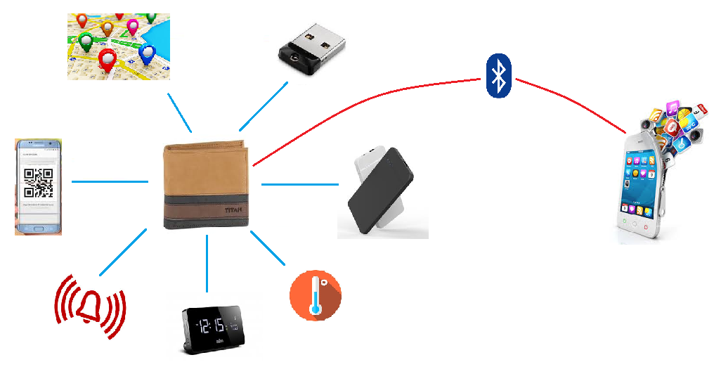
Features diagram
Storage
Bluetooth Communication
Tracking
QR Display
Power Bank
Mobile App
Wallet Finder
Temperature
Digital Timing

Slide 5
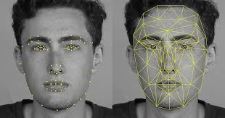
Security (Face Recognition)
In built camera in the wallet is used for facial recognition for high security purpose, by interfacing Arduino with MatLab tool.
Face recognition is for biometric identification to access security in wallet.

Slide 6
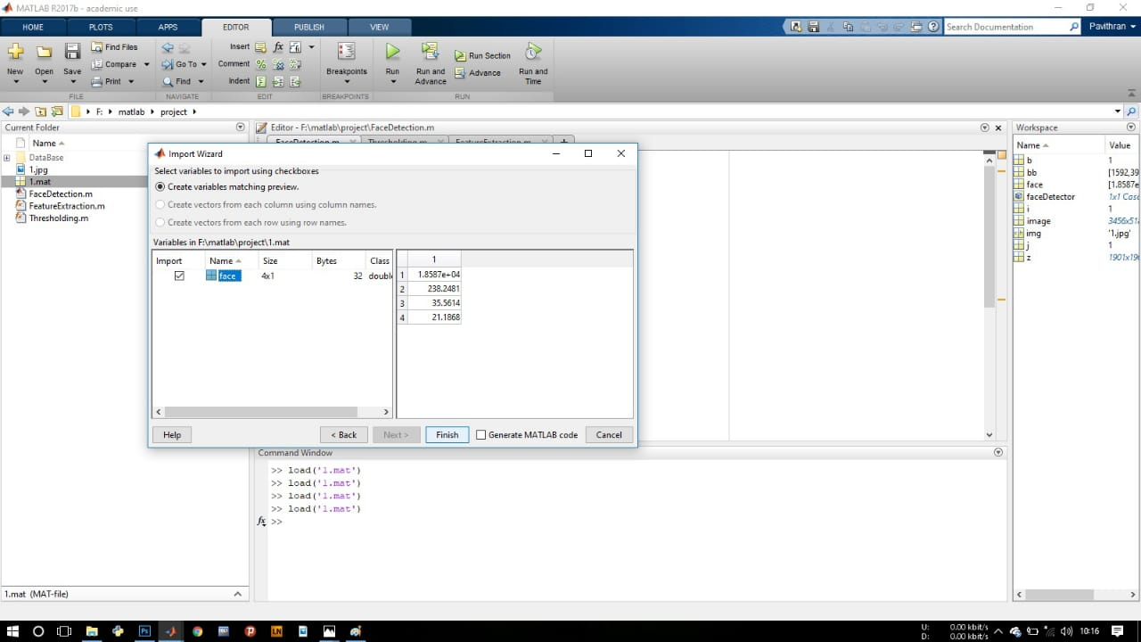
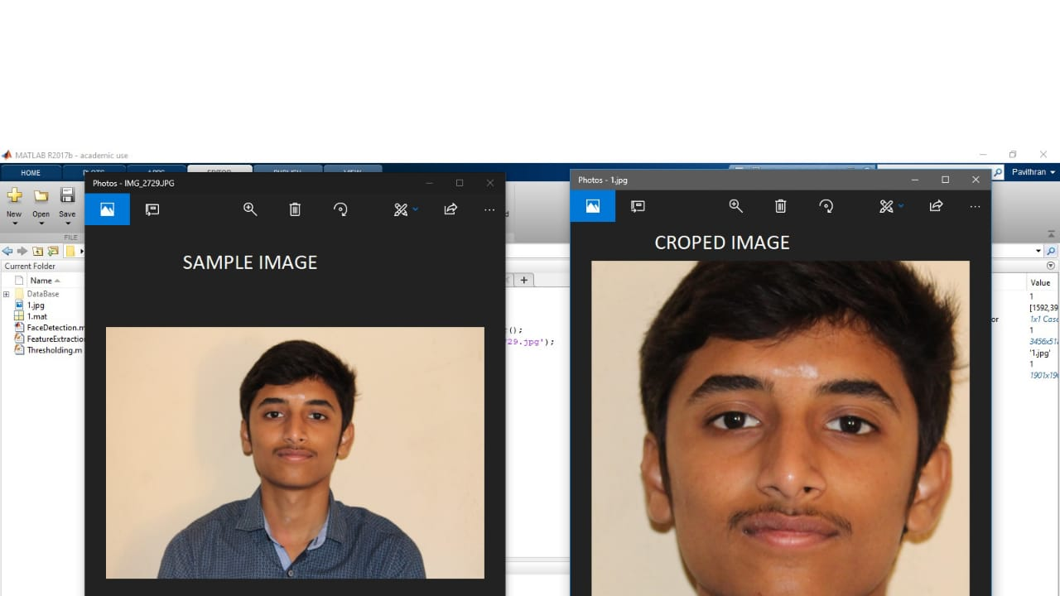
Face recognition using MATLAB

Slide 7
Wireless charging
The Smart Wallet uses wireless battery charging technology to avoid plugging in charger.
To provide comfort and feasibility to the product the wireless charging technology has been introduced.
The Smart Wallet can just be placed on a charging pad to charge the battery in it. The super charging technique helps to charge the battery on a faster rate, as well as long lasting.
This Smart Wallet is smart in its action, compact in size, low cost with many technologies embedded in and useful in consumer’s point of view.

Slide 8
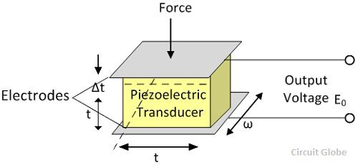
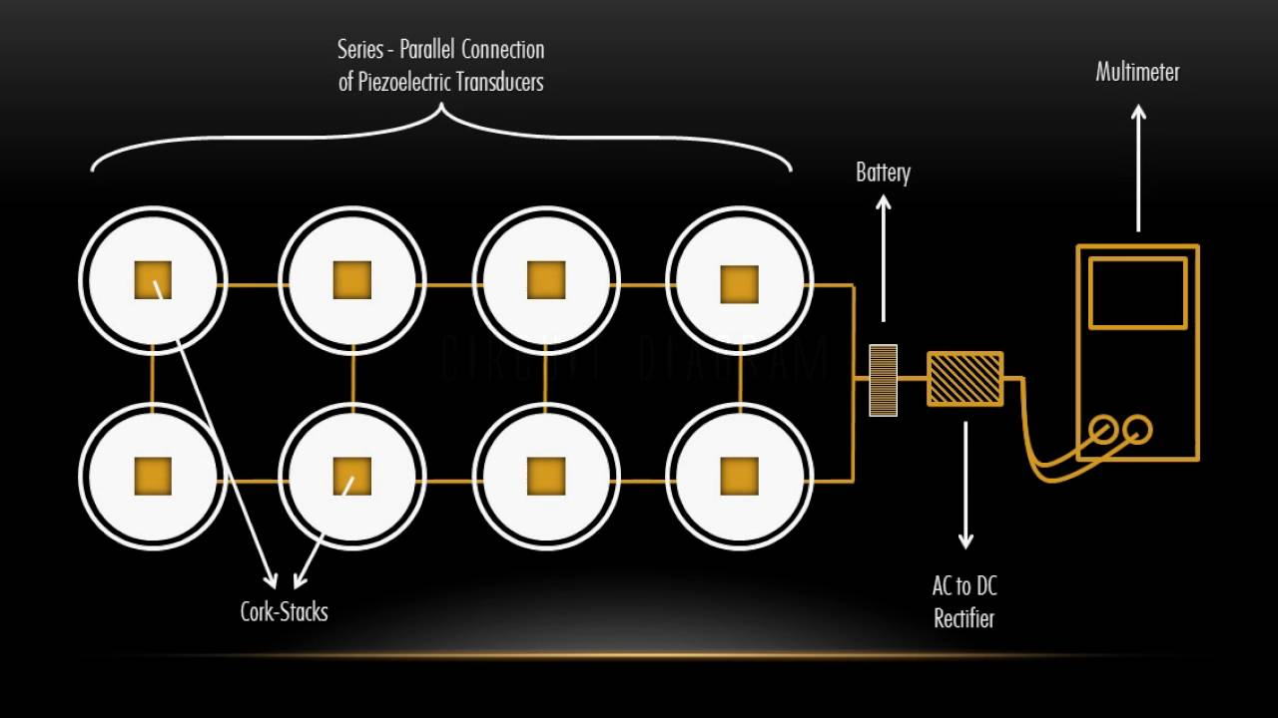
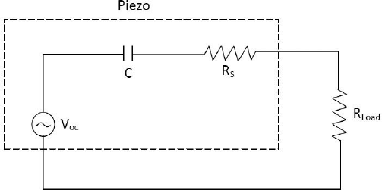
Piezo Electrical Charging from applied pressure on the wallet (Diagram)
Piezo Electric Charging is interfaced with the wallet to charge the batter from the human body.

Slide 9
Piezo Electrical Charging from applied pressure on the wallet (Cont..)
Piezoelectricity, also called the piezoelectric effect, is the ability of certain materials to generate an AC (alternating current) voltage when subjected to mechanical stress or vibration, or to vibrate when subjected to an AC voltage, or both. The most common piezoelectric material is quartz.
Output voltage of piezoelectric crystal can be calculated by using formula :
V = P×g× t
where,
P is the pressure applied in N/(sq.m )
g is the sensitivity of the material
t is the thickness of the material
V is output voltage

Slide 10
DIGITAL DISPLAY
The Smart Wallet displays digital clock,date,temperature & humidity.
The main advantage over the integrating these sensors is, we could get a real time temperature sensing with accuracy.
An 8X2 display unit is embedded in the wallet that is ideal to display the above mentioned parameters.

Slide 11
Live temperature
Wallets is also used to display the live temperature.

Slide 12
Range alarm system
The Wallet includes a sensor circuit i.e. when the wallet is out of range ( say 20m) an alarm is triggered in the mobile application.
Proximity sensors are used to detect the wallet with a specified range from the user.
In case of capacitive proximity sensors, it is used to detect a plastic target while in the case of inductive sensors it detects a metal target. Maximum distance that the proximity sensors can detect is the Range (R).
As the smart wallet is concerned, it uses an ultrasonic proximity sensor that is capable of detecting an object in a range of 3 – 30m.

Slide 13
POWER BANK
The Wallet has a built in power bank with a capacity between 2000 and 5000 mah.
The power bank has two charging facilities.
Primary : Wireless Charging ( just placing the wallet on the charging pad )
Secondary : Using Piezo-Electric transducer circuit.
With the power bank and the piezo-electric transducer circuit integrated the smart wallet weighs comparatively low.
Built-in Power bank fully charges your smartphone on the go. Works both wirelessly and with a cable. Extremely lightweight and thin.

Slide 14
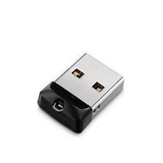
Storage
Storage in the wallets is used to avoid carrying the pendrive with the wallet user.

Slide 15
Indoor tracking
With the help of buzzer, the miss placed wallets can be identified easily.

Slide 16
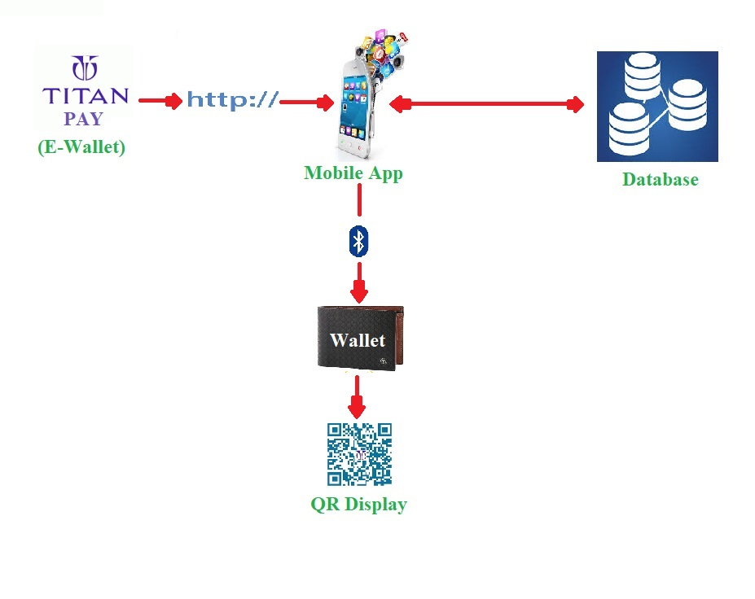
QR Display
Smart wallets can also be used as a e-wallets.
QR display in the wallets is used to make payments mobile free.

Slide 17
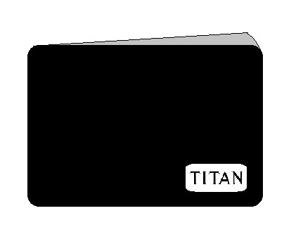
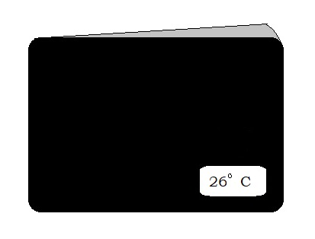
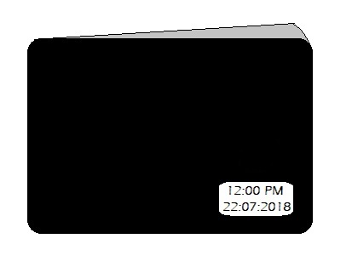
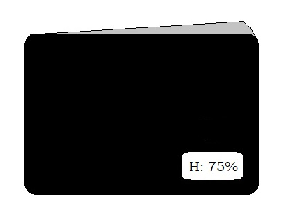
Smart wallet Design (Front Flip)
TITAN logo, Digital timing, Temperature, Humidity is displayed in the front flip
TITAN Logo
Temperature
Time and Display
Humidity

Slide 18
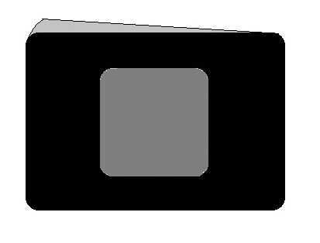
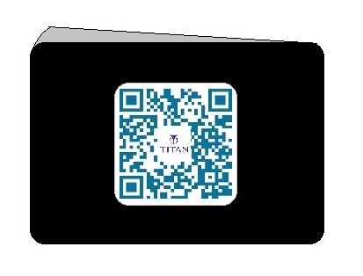
Smart wallet Design (Back Flip)
Back Flip
Back Flip
Small graphical display is used to display the QR to send and receive money.
The QR is displayed from the Database.
Display
Display

Slide 19
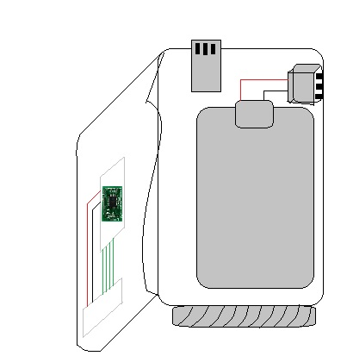
Smart wallet Design
(Interior hardware )
Front Flip Inner side
Storage
Power Bank Output
Processor
Back Flip Inner Side
Battery
Wireless Charging Device

Slide 20
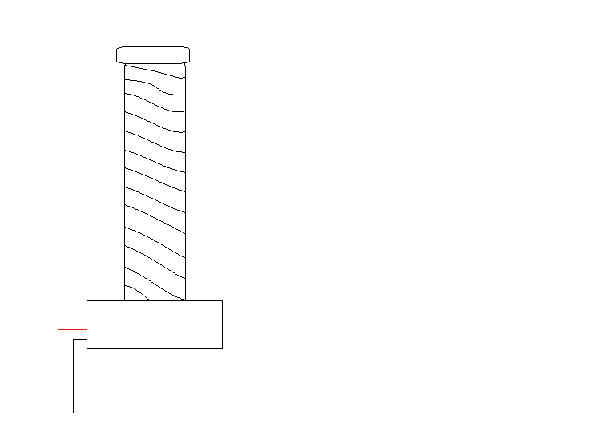
Wireless charger
The charging of the wallet is done in wireless mode. It has been prototyped as Tesla Coil.
Wireless Charger

Slide 21
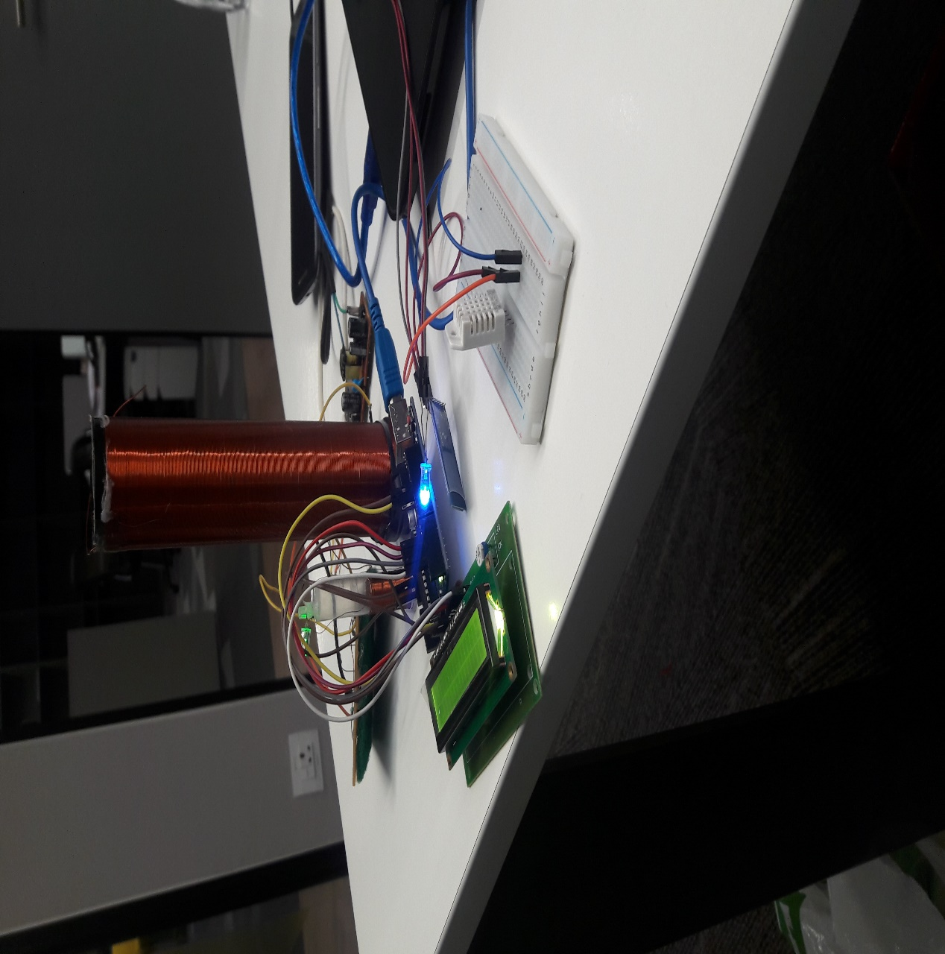
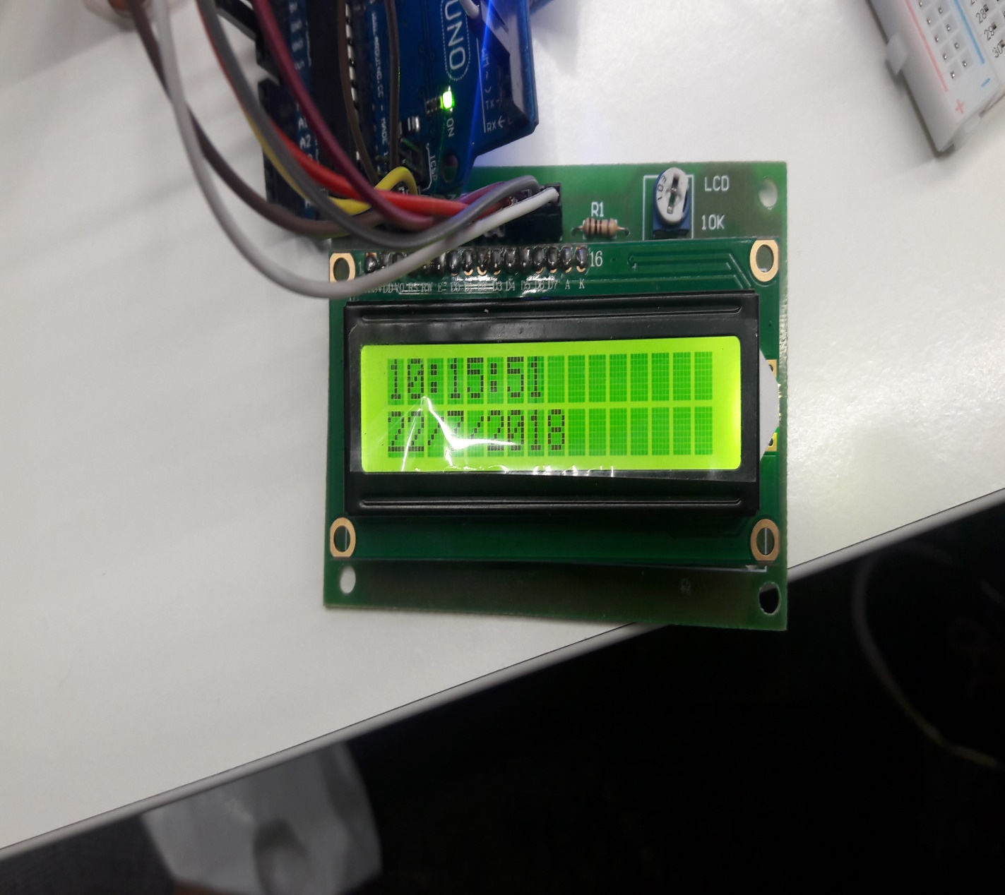
Prototype

Slide 22
Thank You

